Slide 1







Slide 2

Selenium

Slide 3
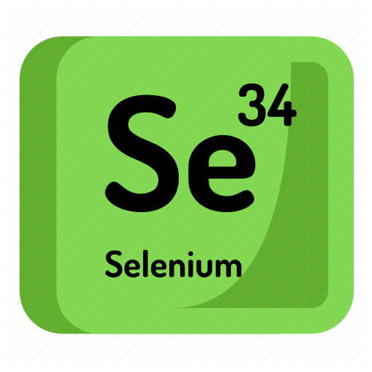
Meaning?
Chemical element with atomic number 34.
Grey crystalline non-metal with semiconducting properties
Increased dietary selenium intakes reduce the effects of mercury toxicity

Slide 4
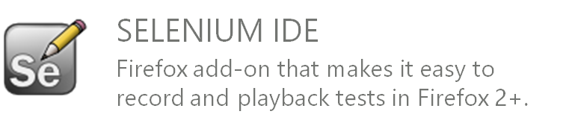
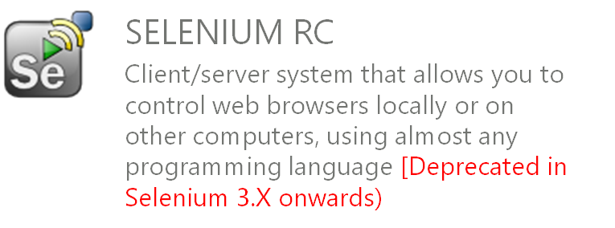
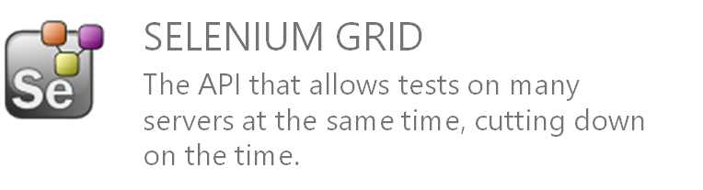
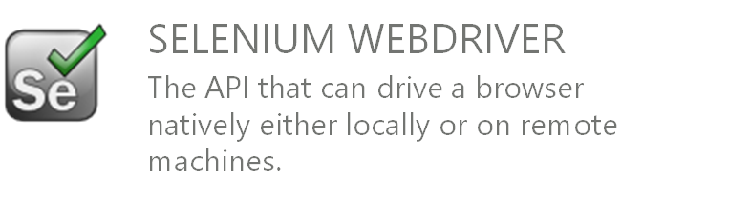

Selenium Projects
The Latest Version is
4.0.0 - alpha-5

Slide 5


History

Slide 6
History
2004 - Jason Huggins was testing an internal application at Thoughtworks.
That library eventually became Selenium Core, which underlies all the functionality of Selenium Remote Control (RC) and Selenium IDE.
In 2006, Simon Stewart started work on a project – WebDriver. Google had long been a heavy user of Selenium, but testers had to work around the limitations of the product.
Simon Stewart, the creator of Selenium WebDriver, in a joint email to the WebDriver and Selenium community on August 6, 2009.

Slide 7











Simon Stewart
Julian Harty
Jari Bakken
David Burns
Anthony Long
Jim Evans
The Origin
Since 2007
Since 2009
Since 2010
Since 2008
Since 2009

Slide 8

TODAY

Slide 9

Browsers Supported

Slide 10





Platform/OS Supported

Slide 11






Languages Supported

Slide 12
<Tags>

Slide 13
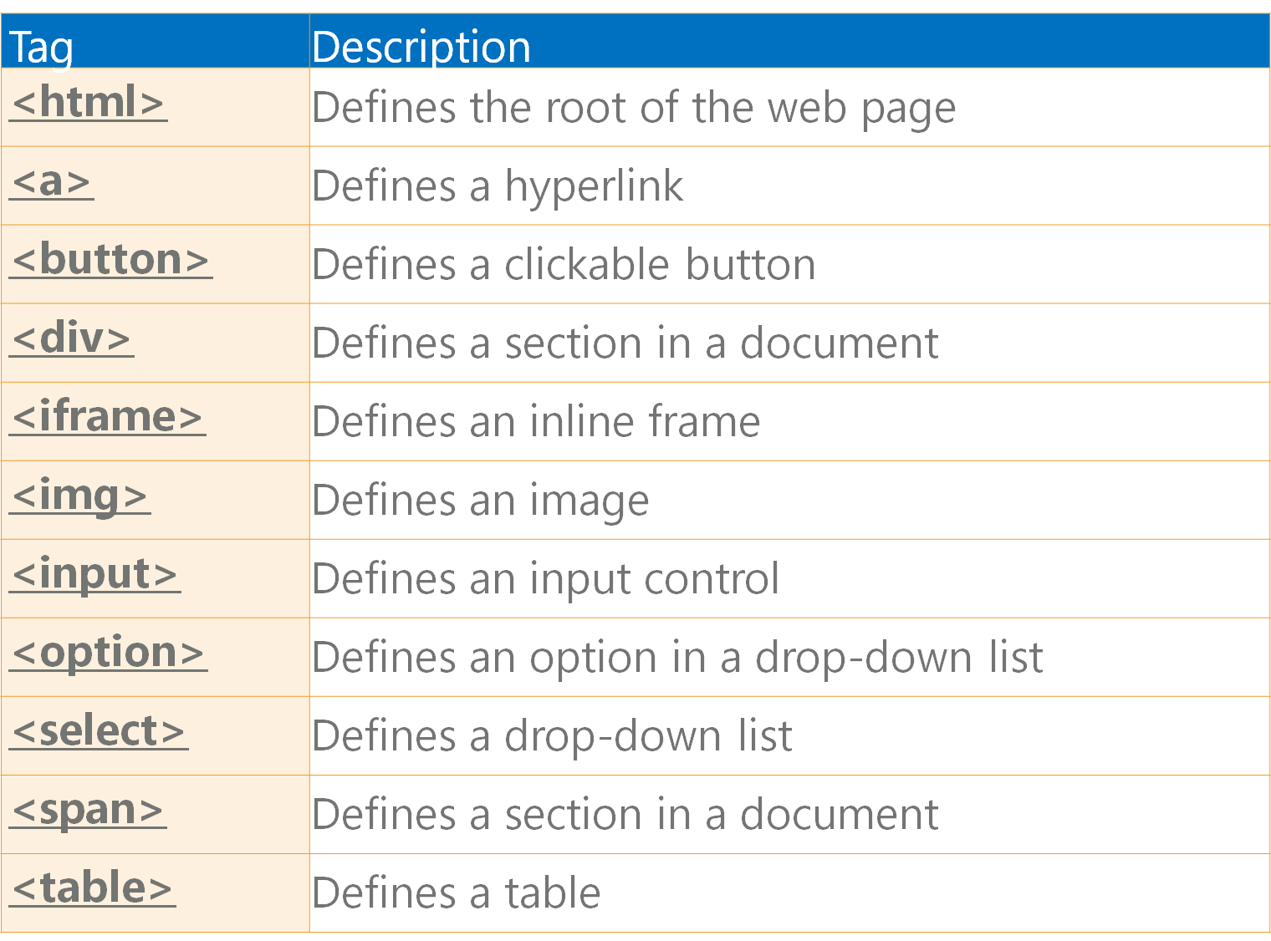
Common HTML Tags
These tags are mostly used in Selenium WebDriver

Slide 14

Locators

Slide 15
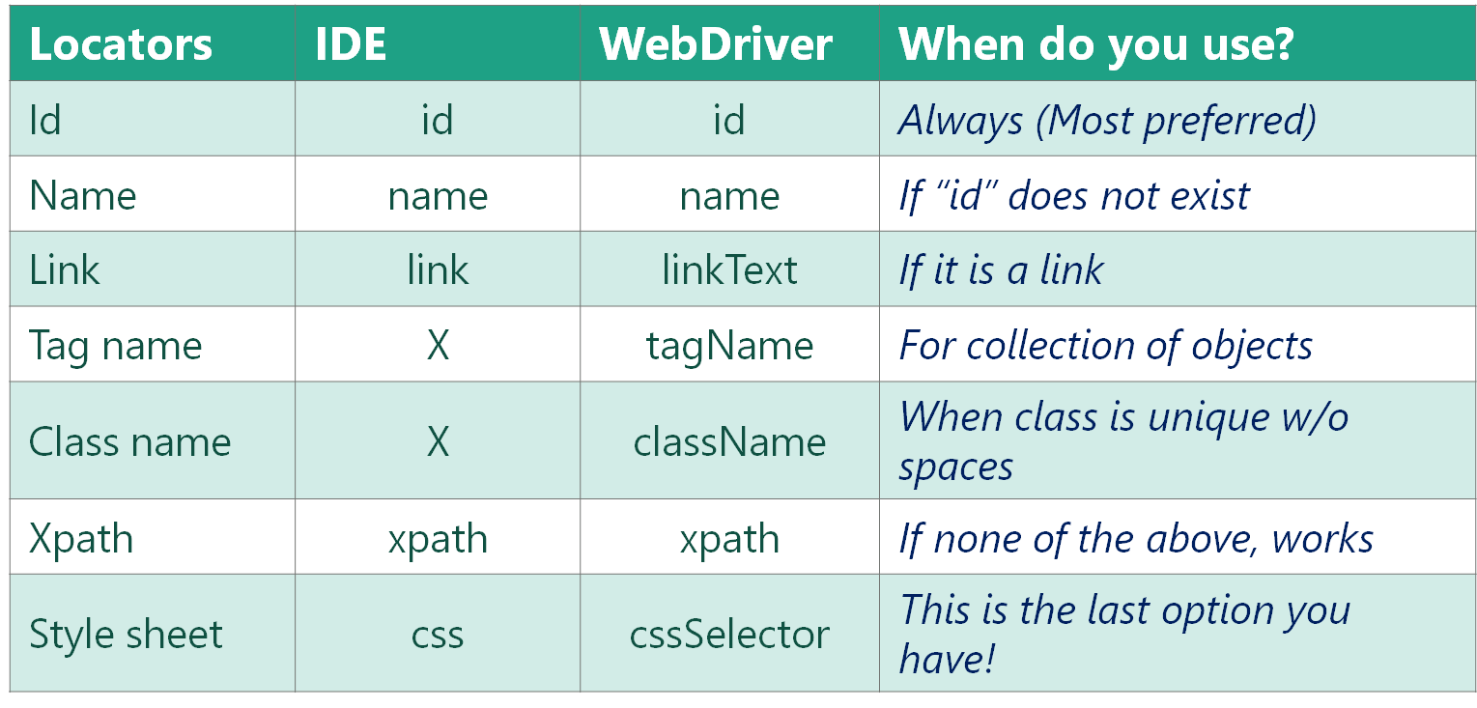
Locators

Slide 16
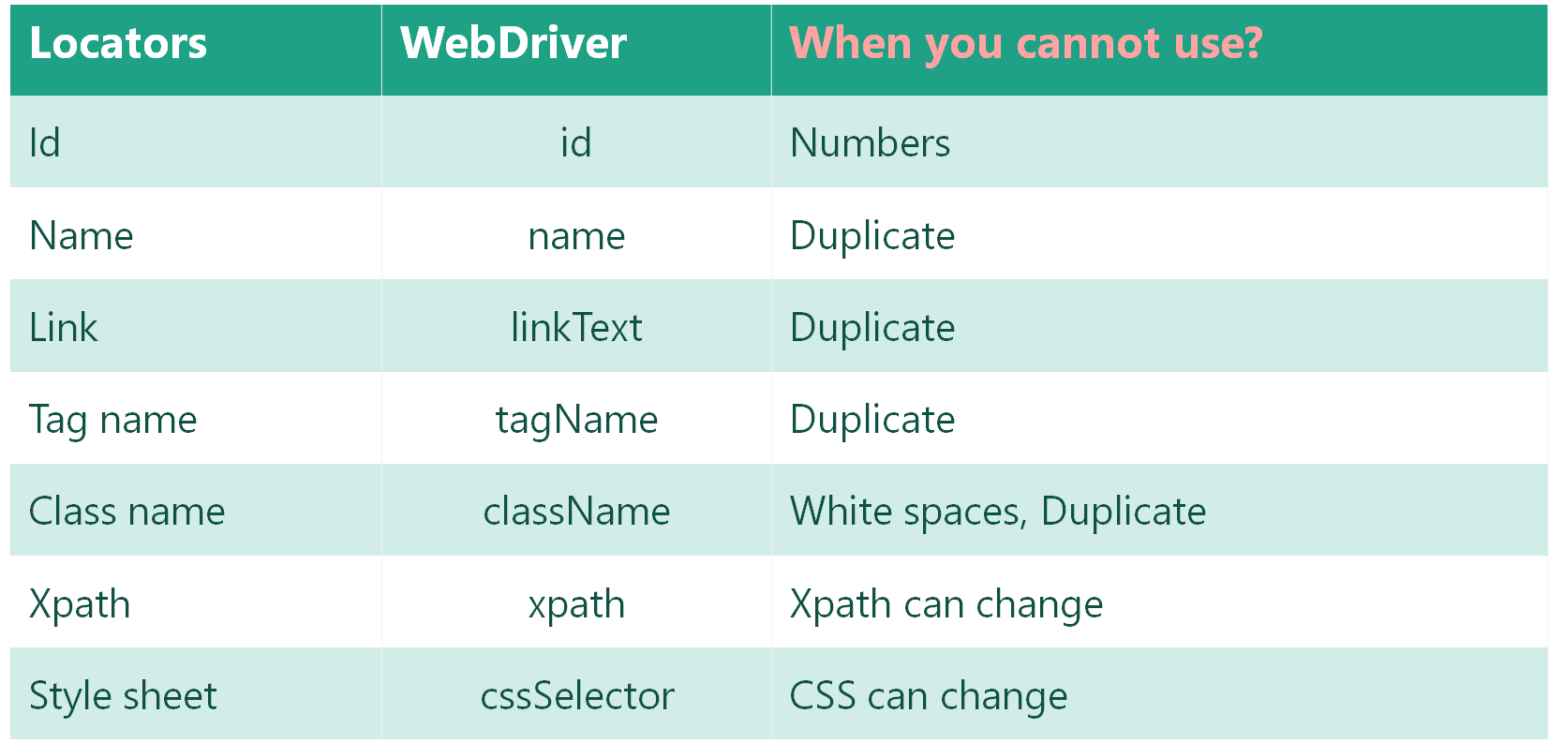
Locators

Slide 17




TOOLS

Slide 18


